Slide 1
Earth Science Notes
Radiocarbon Dating

Slide 2
Objectives
I can…
Compare and contrast Absolute dating with Relative dating of rocks.
Explain the concept behind Carbon-14 dating.
Describe the process that forms Carbon-14.
Explain how Carbon-14 gets into living things.

Slide 3
Radiocarbon Dating
Recall: There were two ways of dating rock strata
Relative Dating
Using The Six laws
Absolute Dating
Using radioisotopes

Slide 4
Radiocarbon Dating
Carbon-14 dating is a way of determining the age of formally living things up to about 50,000 years old.
Carbon-14 can date things like bone, cloth, wood and plant fibers.

Slide 6
How Carbon 14 is made?
Cosmic ray hits an atom in the atmosphere dislodging a neutron from it
Neutrons collide with nitrogen and knock out a proton creating a carbon atom
N – 14 (7 protons and seven neutrons)
C – 14 (6 protons and eight neutrons)
Carbon – 14 is unstable meaning it will decay

Slide 7
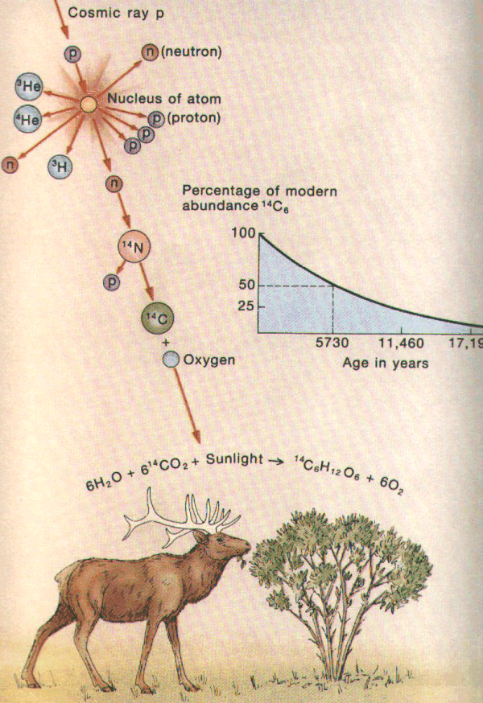
How Carbon 14 gets into Living Things
Carbon-14 combines with oxygen and plants take it in
Animals that eat plants take in C – 14

Slide 8
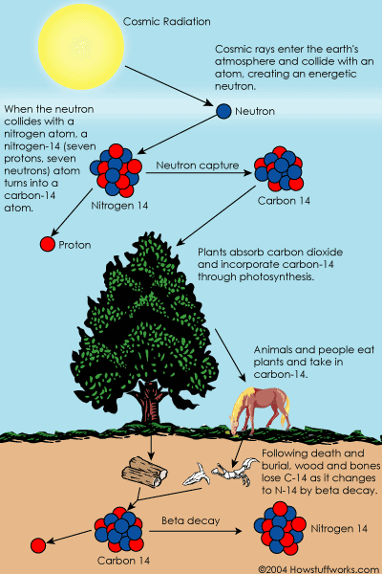
How Carbon 14 gets into Living Things

Slide 9
How Carbon 14 Dating Works
The amount of carbon-14 in the air and in all living things at any given time is nearly constant.
The carbon-14 atoms are always decaying, but they are being replaced by new carbon-14 atoms at a constant rate.
At this moment, your body has a certain percentage of carbon-14 atoms in it, and all living plants and animals have the same percentage.

Slide 10
How Carbon 14 Dating Works
As soon as a living organism dies, it stops taking in new carbon-14.
The amount of carbon-14 at the moment of death is the same as every other living thing, but the carbon-14 decays and is not replaced.
The carbon-14 decays with its half-life of 5,700 years

Slide 11
How Carbon 14 Dating Works
By looking the amount of carbon-14 in the sample and comparing it to the amount in a living organism, it is possible to determine the age of a formerly living thing fairly precisely.
Mass | Time
100 g | 0 y
50 g | 5,700 y
25g | 11,400 y
12.5 g | 17,100 y
6.25 g | 22,800 y
3.125 g | 28,500 y
1.5625 g | 34,200 y
Consider a 100 g sample of C-14

Slide 12
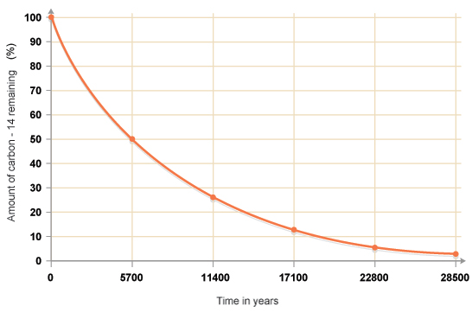
Mass | Time
100 g | 0 y
50 g | 5,700 y
25 g | 11,400 y
12.5 g | 17,100 y
6.25 g | 22,800 y
3.125 g | 28,500 y
1.5625 g | 34,200 y

Slide 13
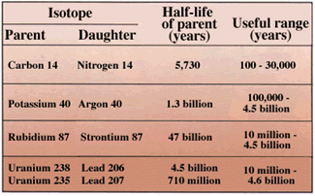
Other Radioisotopes used for Dating

Slide 14
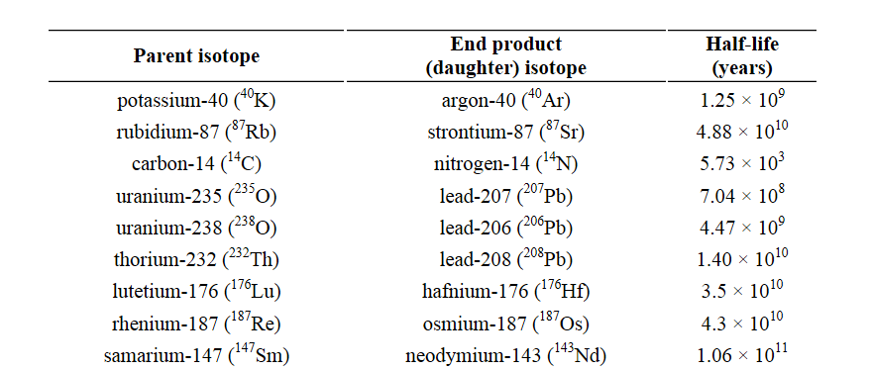
Other Radioisotopes used for Dating

Slide 15
Questions about Carbon-14 Dating
How do we know the organic samples start with the same amount of C-14?
Seashells?
Burned Trees?
How do we know if the rate of decay has always been constant?

Slide 16
Radiocarbon Dating
Summary
Absolute Dating of Rock involves using radioisotopes
Radioisotopes have half-lives that can be used to date rocks
Carbon-14 is produced when a stray neutron hits a nitrogen atom replacing one of the protons
Carbon-14 enters living things when plants absorb CO2 that contains C-14
Its assumed that C-14 is constant for all living things
C-14 decays at a constant rate and can be used to date materials

